Slide 1
IT5005 Artificial Intelligence
Lecture 1: Intelligent Agents

Slide 2
Topics Covered
Part 1 - Functions
1.1 Motivation
1.2 Example Agent Components
1.3 The Wumpus World
1.4 Logic

Slide 3
Motivation
Intelligent Agents

Slide 4

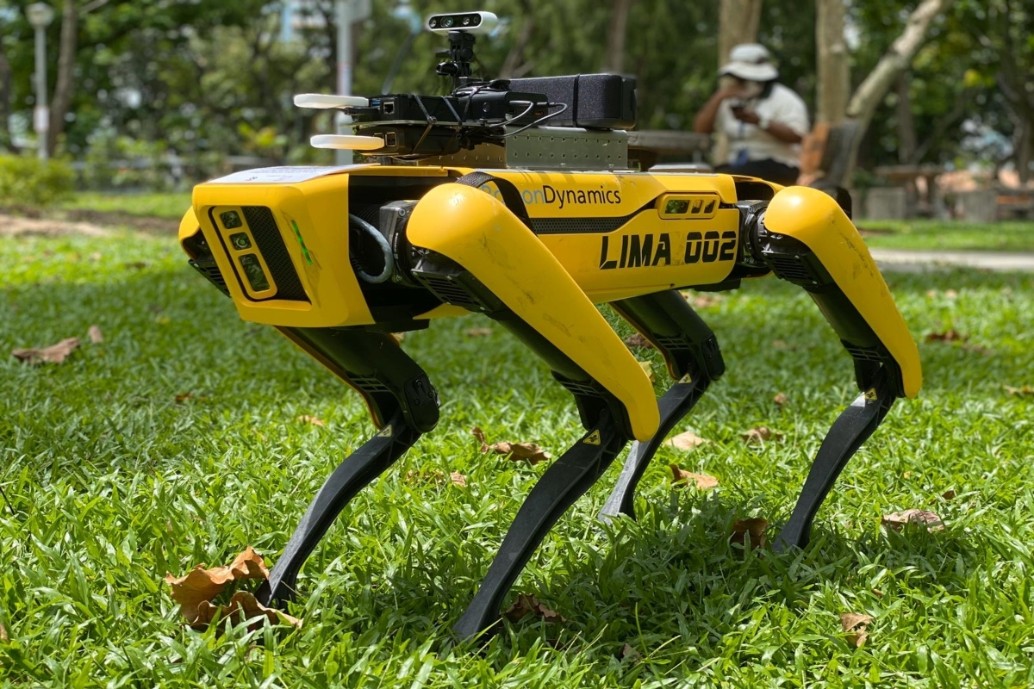
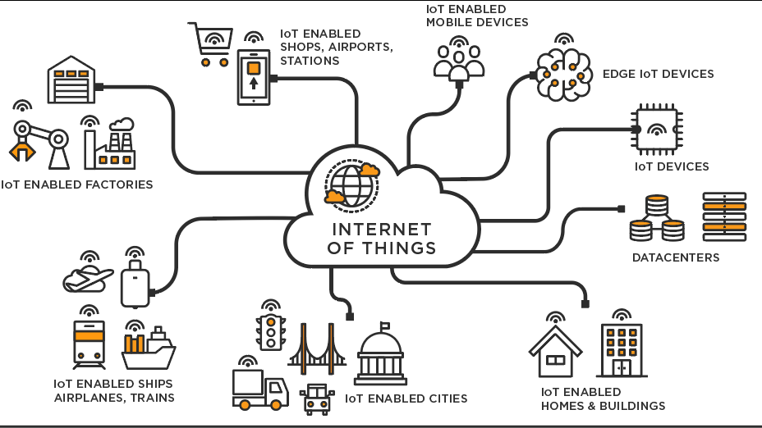
1.1 Motivation
One of our big motivations in AI is to create knowledge-based agents. These can be:
People like you and me.
An actual hardware robot.
Software simulations of robots.
Programs that interact with each other or with people over the Internet.
Pervasive “Internet-of-Things” style systems.
…?

Slide 5
1.1 Motivation
An intelligent agent can:
Sense, or otherwise gather information about the environment around it.
Form “sentences” about what it has sensed, and store these in its “Knowledge Base”.
Infer new knowledge from the knowledge base.
Make decisions and take actions using “actuators” based on these decisions.

Slide 6
Example agent components
Intelligent Agents

Slide 7
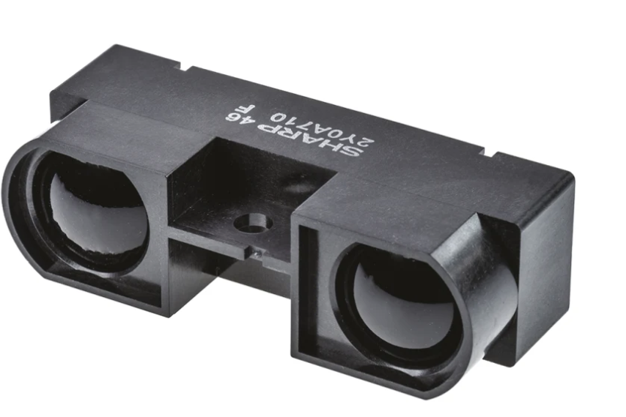
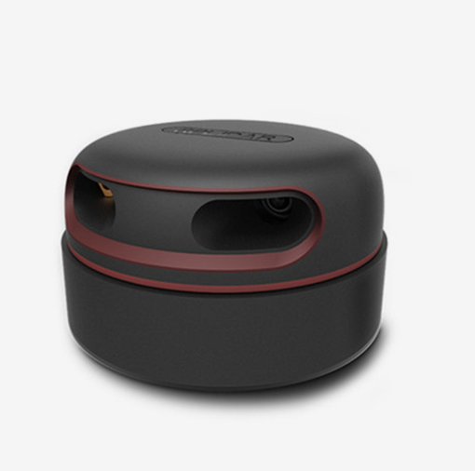
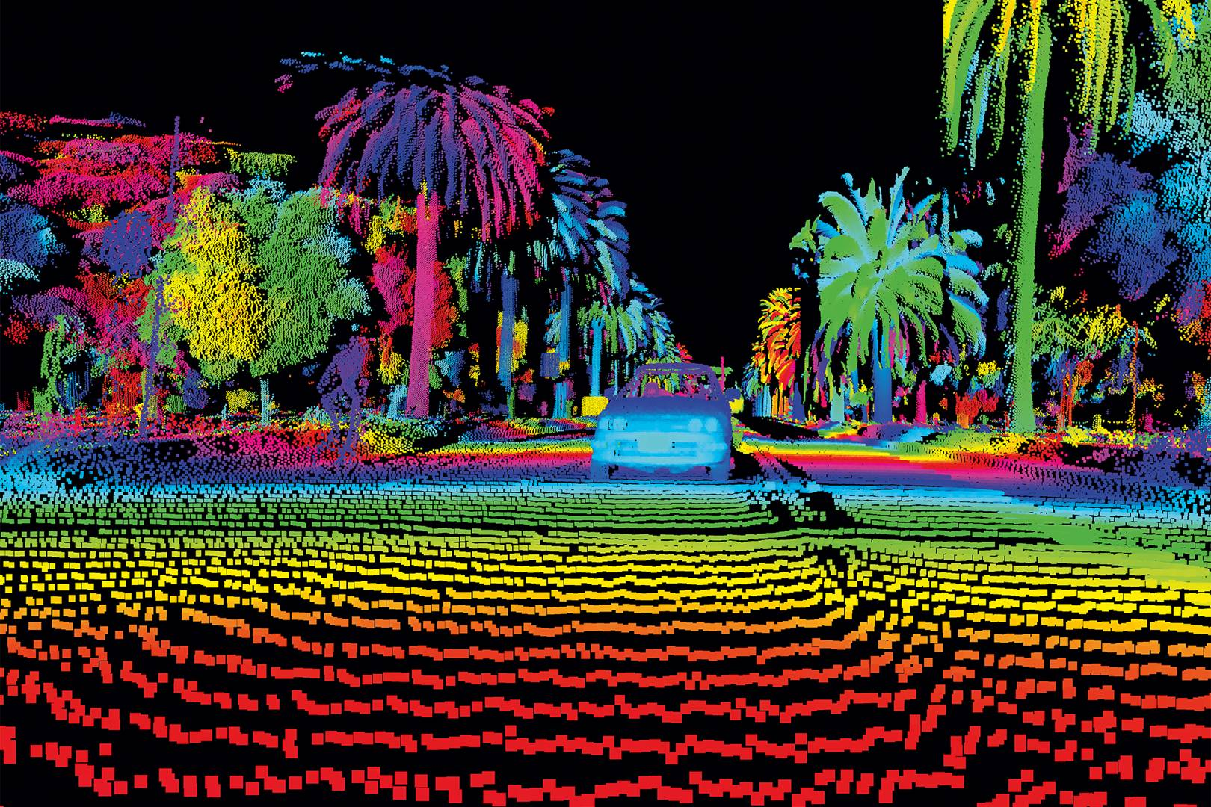
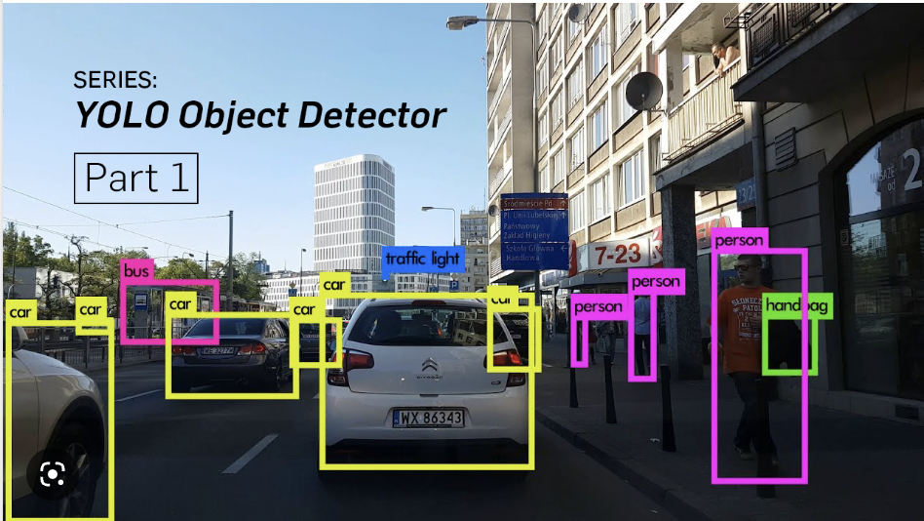
1.2 Example Agent Components
Example sensors:
Infrared sensors, LIDAR, microswitches, accelerometers and gyroscopes, etc.
Tells the agent about the environment.
May also get this information from other computer systems.

Slide 8
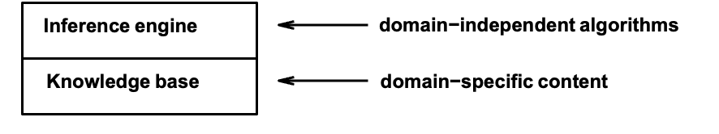
1.2 Example Agent Components
Knowledge Bases
Made up of:
A domain independent inference engine that infers knew knowledge and makes decisions.
A domain dependent knowledge base consisting of ”sentences” specified in a. formal language.

Slide 9
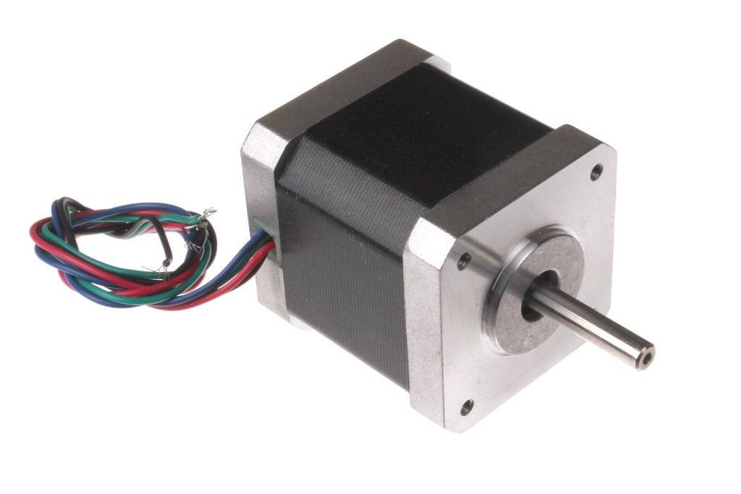
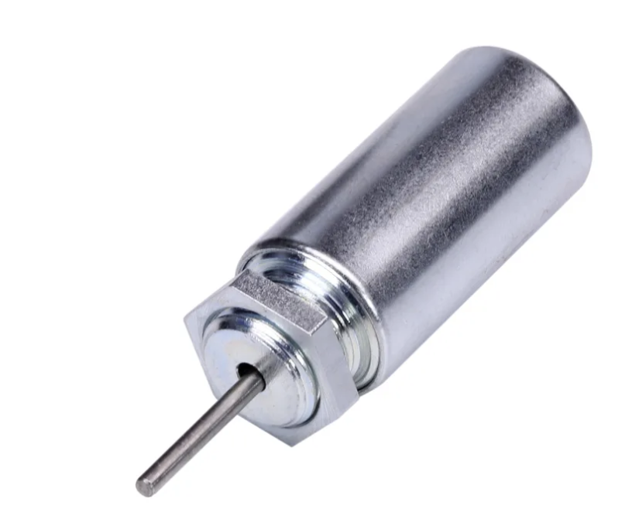
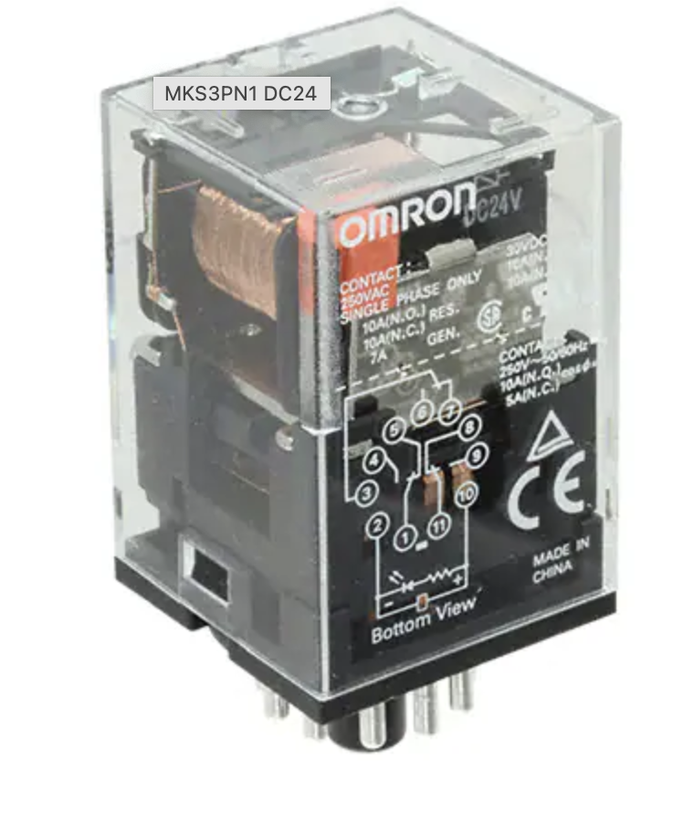
1.2 Example Agent Components
Actuators
Devices that the agent uses to effect changes in its surrounding.
Examples: Motors, solenoids, relays, speakers, LEDs, etc.

Slide 10
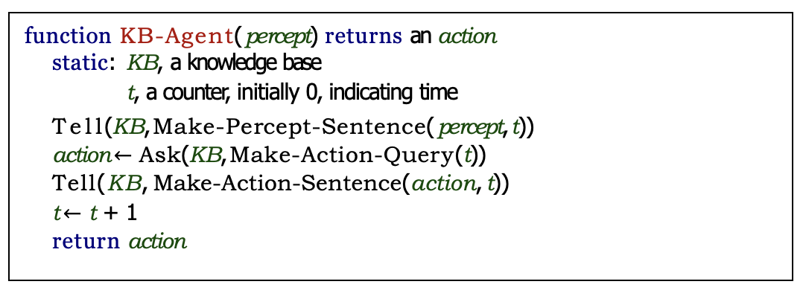
1.2 A Simple Knowledge Based Agent

Slide 11
The wumpus world
Intelligent Agents

Slide 12
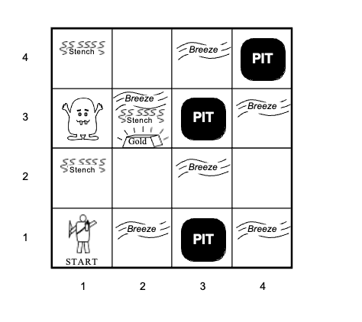
1.3 The Wumpus World
You are an agent in a 4x4 world called the “Wumpus World”.
You always begin at (1, 1) facing east.
A pot of gold, pits, and one scary Wumpus are randomly placed amongst the grids.
If you go into a square with a pit or a Wumpus, you will die.
There is a breeze in squares directly (and not diagonally) around pits.
There is a stench in squares directly (and not diagonally) around the Wumpus.
In each turn you can turn north, south, east or west and move one square.

Slide 13
1.3 The Wumpus World
You can shoot your single arrow and kill the Wumpus if you are facing it.
If you reach back to (1, 1) you can climb out.
Scoring system:
Gold, +1000 points.
Death, -1000 points.
-1 point per step.
-10 points for using the arrow.
Your sensors can sense a breeze, stench, glitter (you found the gold!).

Slide 14
logic
Intelligent Agents

Slide 15
1.4 Logic
Logic:
A system of symbols, formal language, operators and inference rules that lets you draw sound conclusions about the world around you.
We will now look at two major classes of logic:
Propositional Logic
This is logic over particular statements about particuar “things” (or a thing).
First Order Logic, also called Predicate Logic
This is logic over classes and groups of “things” (or a thing).
We will be using materials covered in CS1231/TIC1201 Discrete Structures:
Much more rigorous and complete than the textbook.

Slide 16
1.4 Logic
Our knowledge base will then consist of:
Observations from our sensors, written as statements in our logic language.
A set of conclusions that can be drawn from the observations, again written as statements in our logic language.
A set of inference rules that can be applied to derive valid conclusions and actions to be taken.

Slide 17
END OF FILE

